Slide 1

Lab 10 Genomic Data Commons (GDC) Lab
EE542 – INTERNET AND CLOUD COMPUTING
Date: 10/22/2018
GitHUB LINK :
https://github.com/jayjadav08/EE542_Lab10
Team Members
Gandhi Rajan Ramachandran
Jay Jadav
Karunveer Singh

Slide 2
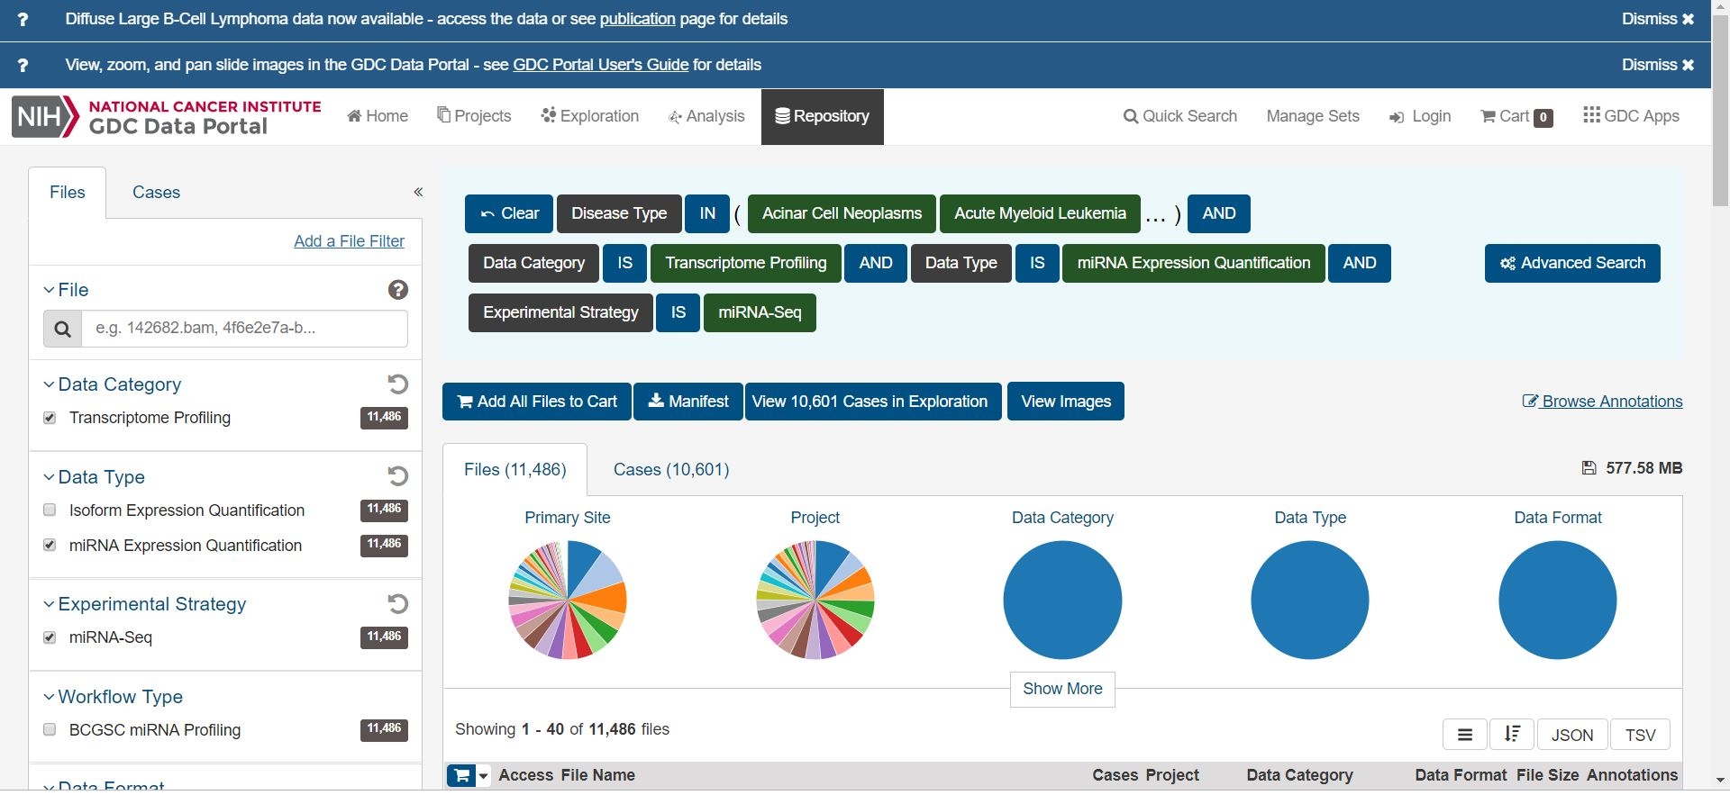
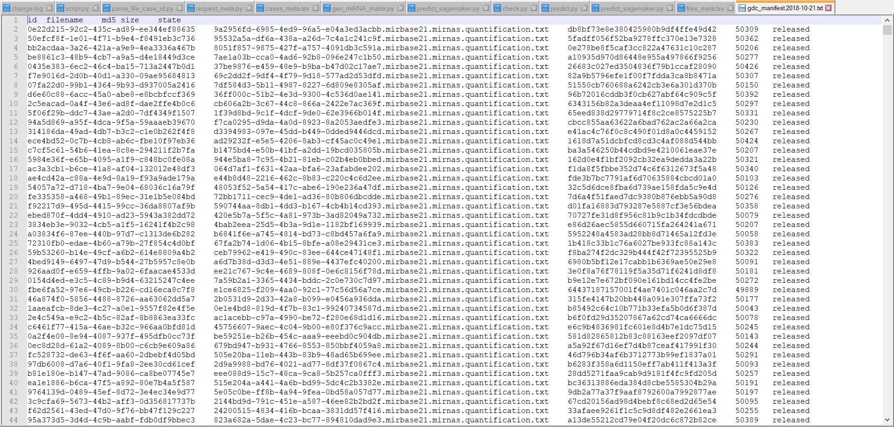
Data Pruning
Initially visit https://portal.gdc.cancer.gov/repository to retrieve the cases and files
Click the Cases tab and select all the disease types
Then go to the files tab and select the following three features
Data Category: Transcriptome Profiling
Data type : miRNA Expression Quantification
Experimental Strategy: miRNA-Seq
After pruning unnecessary data, we have 11486 files.
The next step is to preprocess this huge data set and apply machine learning algorithm to predict disease types
SAMPLE SCREEN SHOT FOR MANIFEST FILE

Slide 3
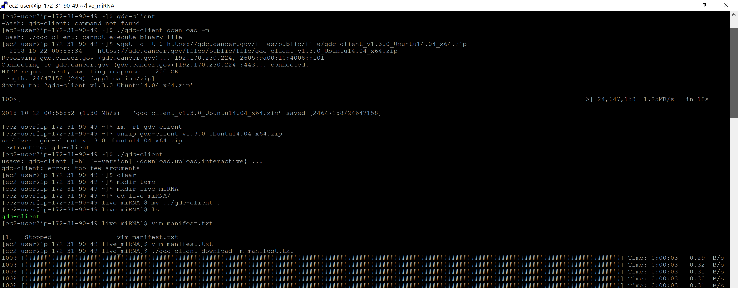
Data Downloading
Download the gdc-client_v1.3.0_Ubuntu14.04_x64.zip using wget command. Unzip the file and run gdc-client.

Slide 4
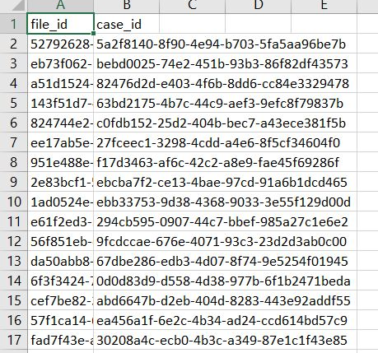
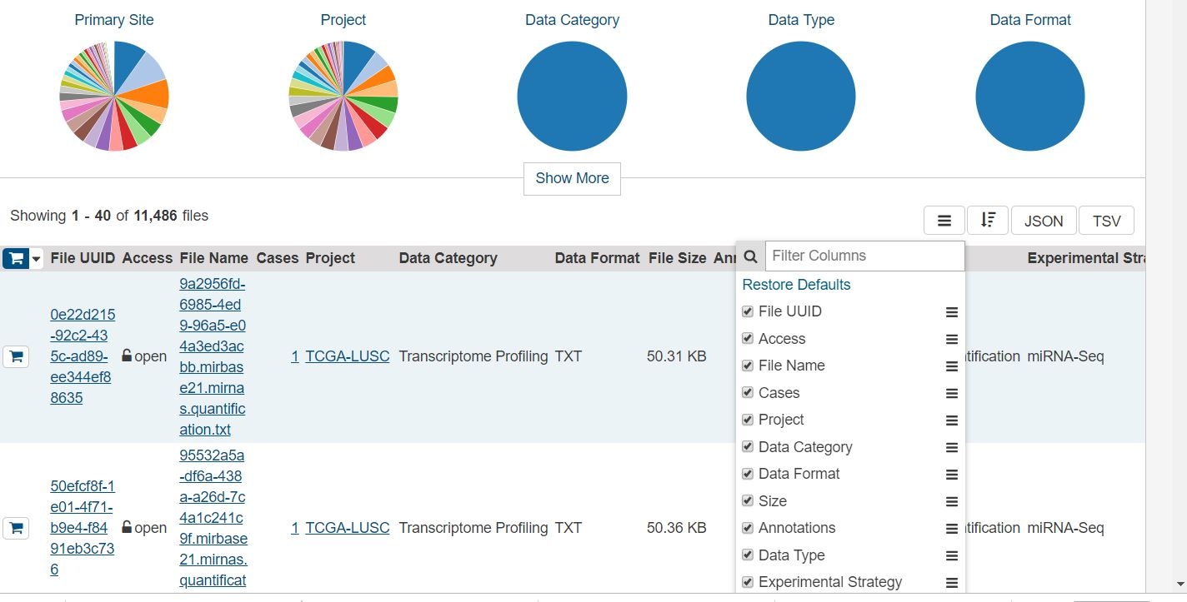
Data Segregation
Now download the json file by clicking the json tab in the repository
Then parse the file id and case id by running the parse_file_case_id.py script
Sample screenshot showing files id and case id parsed version

Slide 5
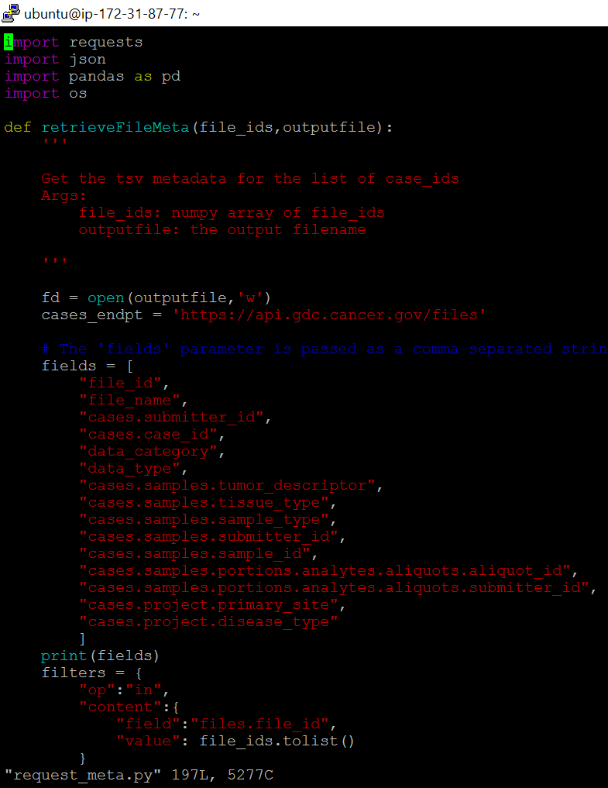
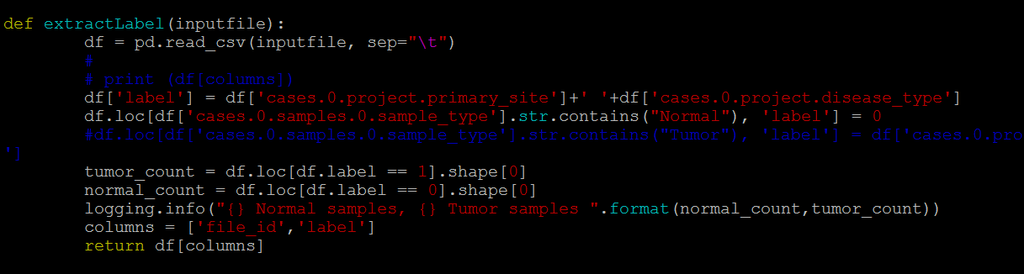
Final Data Processing
Include the following two fields in requests_meta.py
Cases.project.primary_site
Cases.project.disease_type
Generate two files, files_meta.tsv and cases_meta.tsv
Then run gen_miRNA_matrix.py to generate the final matrix miRNA_matrix.csv with defined labels.

Slide 6
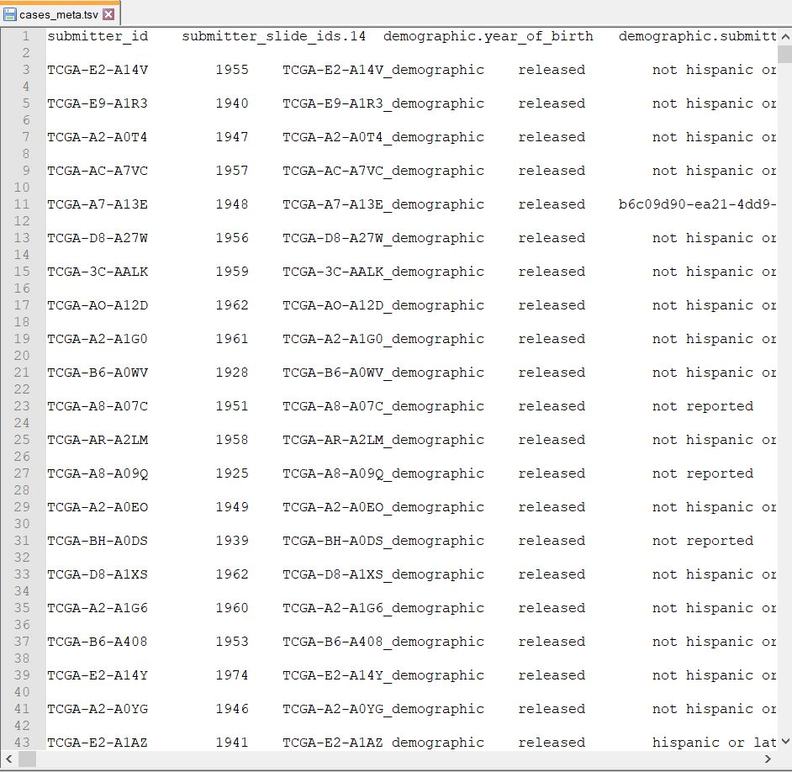
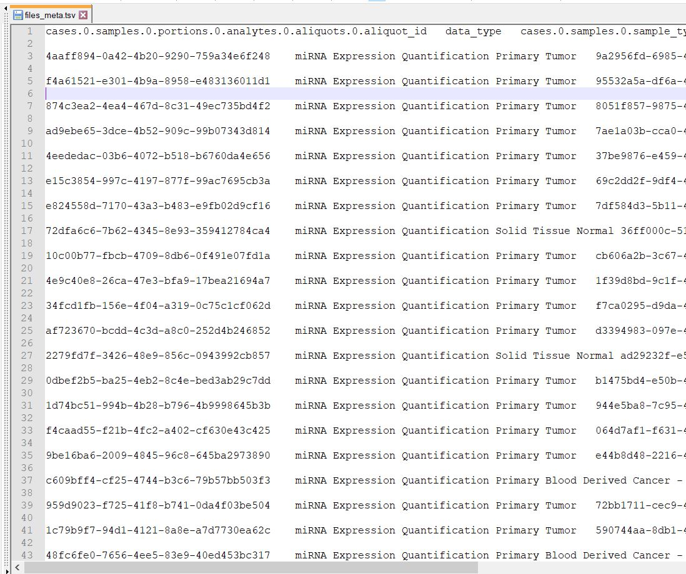
Sample Screen shots for TSV files
Cases_meta.tsv
Files_meta.tsv

Slide 7
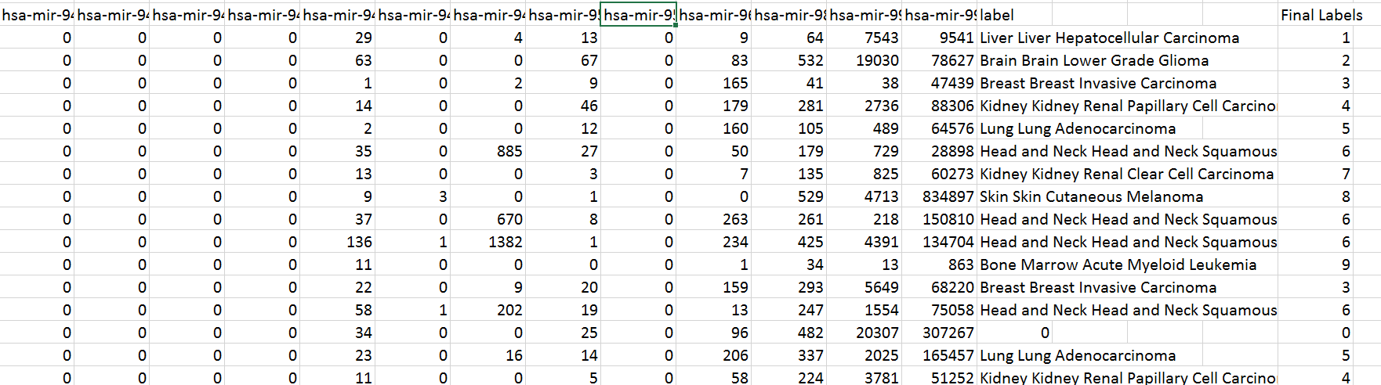
Final miRNA_Matrix Screenshot
Final miRNA_matrix with disease labels. This matrix has been fed as an input to the classification algorithm which can be trained to predict disease types

Slide 8
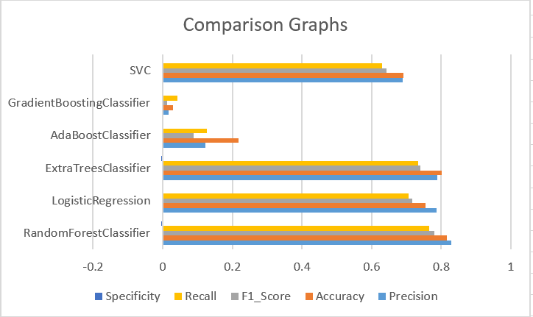
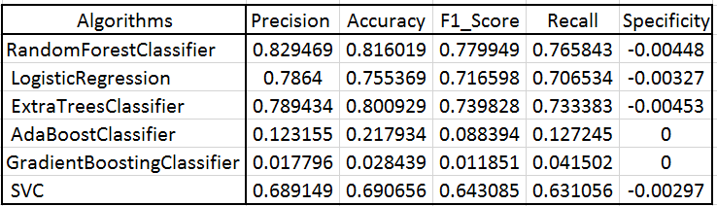
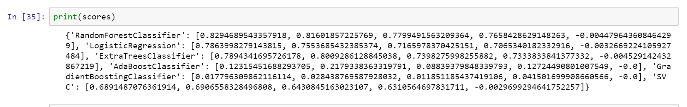
Evaluation Metrics
Finally all the results are tabulated and plotted in the form of graph. Random Forest Classifier is performing well among other algorithms which gives out a maximum accuracy of 82.9 %

Slide 9
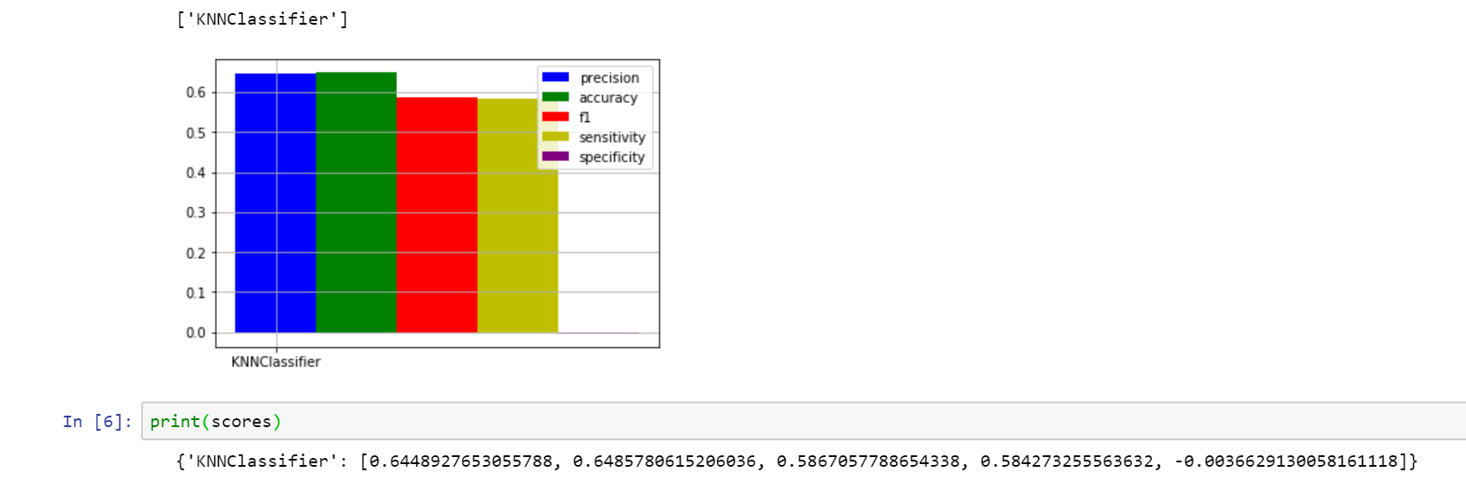
Final Result using KNN Classifier
The accuracy of the KNN Classifier is around 64.48 % whose performance is considered as average when comparing to other algorithms

Slide 10
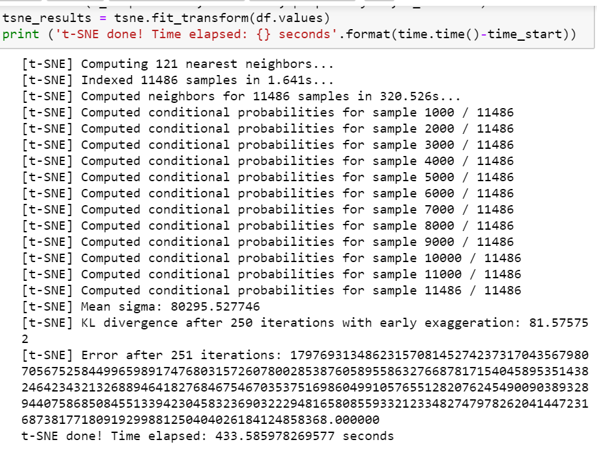
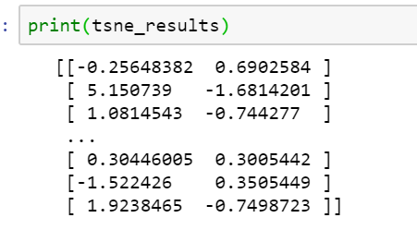
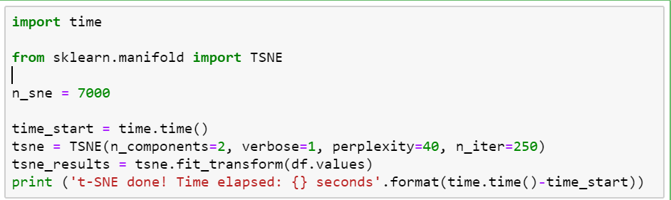
TSNE and PCA Method of Visualization
The TSNE Results obtained can be plotted using ggplot

